Slide 1
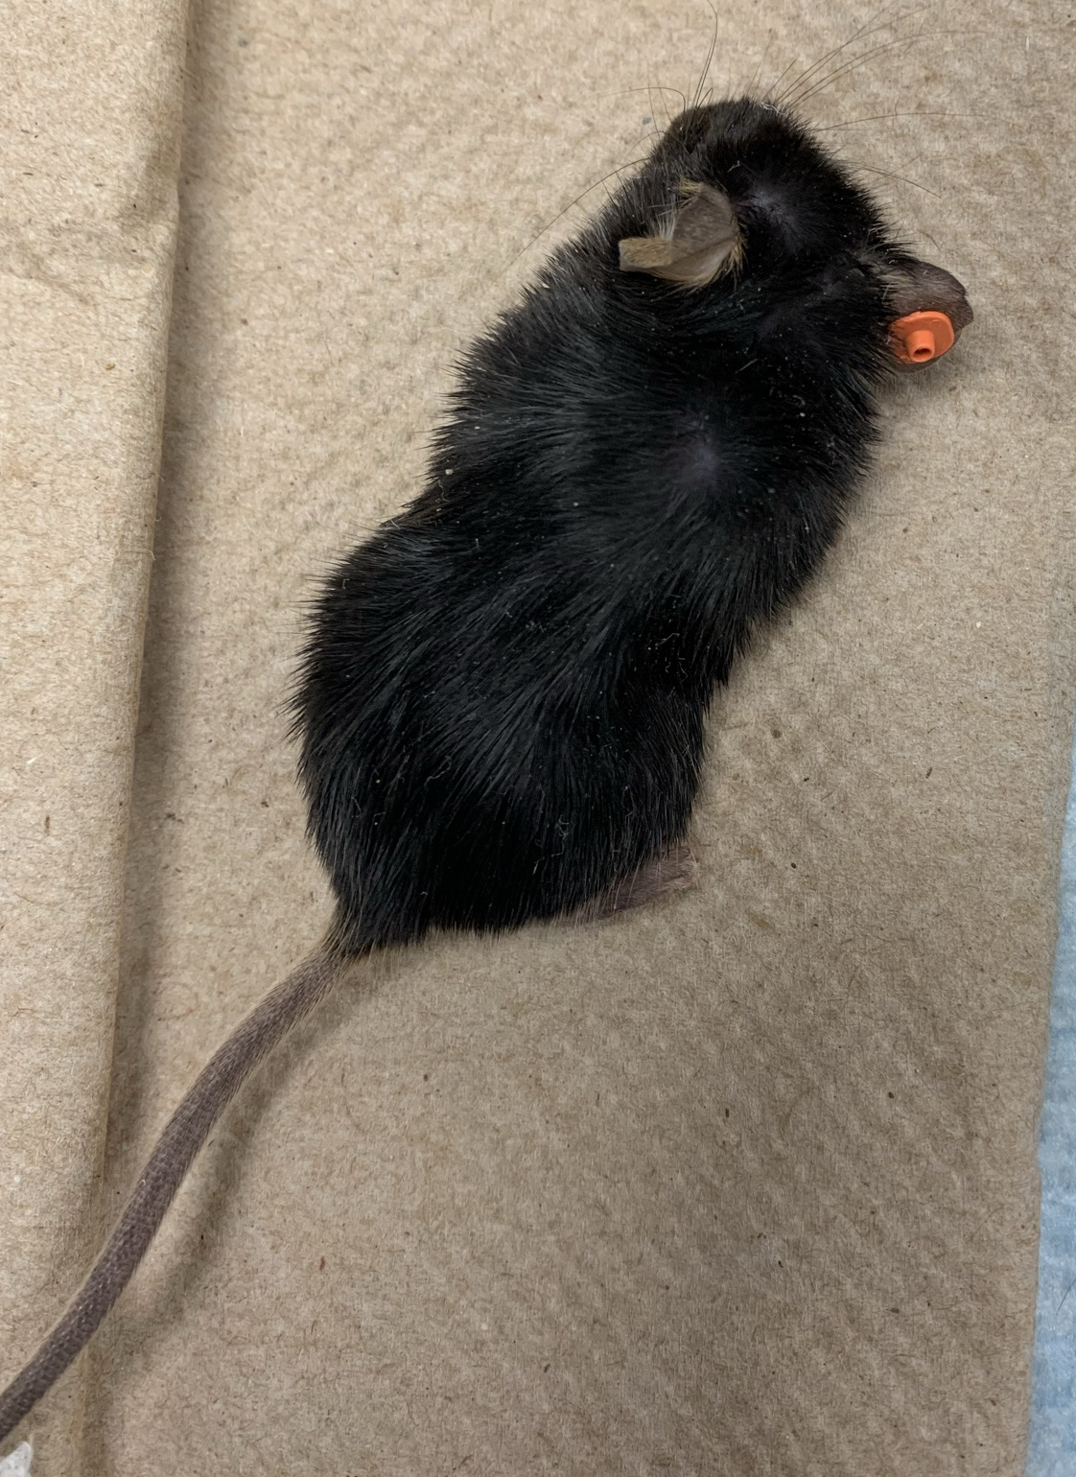
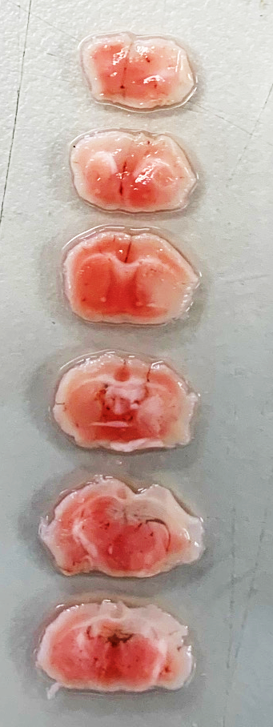
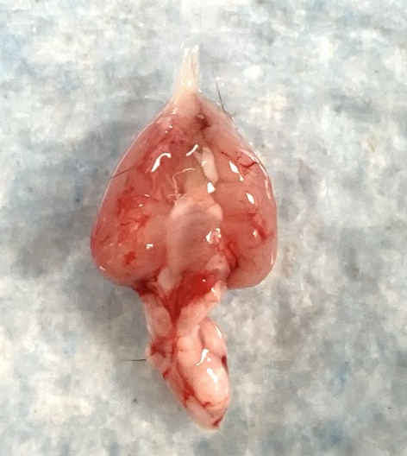
Mouse ID | KX0573
Date of surgery | 10/20/2020
Date of Mortality | 10/27/2020
Day 2 MRI | Yes
Day 7 Behavior | No
Received all the intended treatments | Yes
Visible signs of hemorrhage | No

